Slide 1
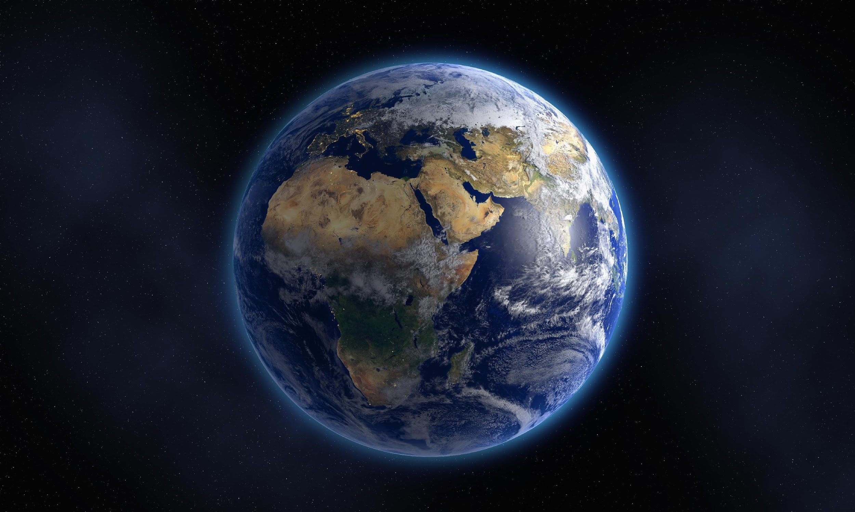
3-D PRINTED MICROCILIA FOR THE REMOVAL OF BIOFILM
1
By: Tiphanie Pfefferle
Northern Arizona University

Slide 2
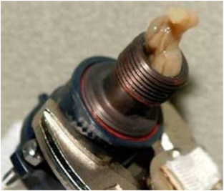
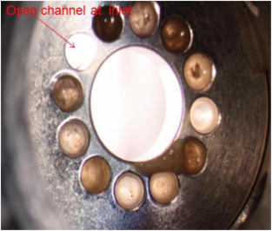
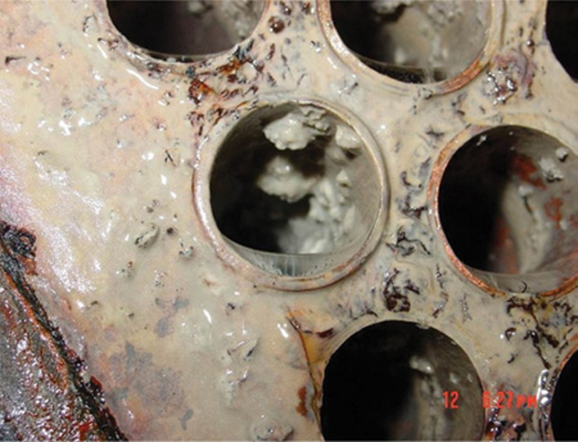
BIOFILM CAN CAUSE HARM TO THE SPACECRAFT AND THOSE ON IT
2
Escherichia coli, Pseudomonas aeruginosa, and Streptococcus equi are common bacteria that make up biofilms.
Zea, L.; Nisar, Z.; Rubin, P.; Cortesão, M.; Luo, J.; McBride, S. A.; Moeller, R.; Klaus, D.; Müller, D.; Varanasi, K. K.; et al. Design of a Spaceflight Biofilm Experiment. Acta Astronaut. 2018, 148 (December 2017), 294–300. https://doi.org/10.1016/j.actaastro.2018.04.039.
Vasilescu, S. The Science Behind Biofilms and Their Impact on Cooling Towers https://www.watertechonline.com/process-water/article/16210901/the-science-behind-biofilms-and-their-impact-on-cooling-towers (accessed Feb 21, 2020).

Slide 3
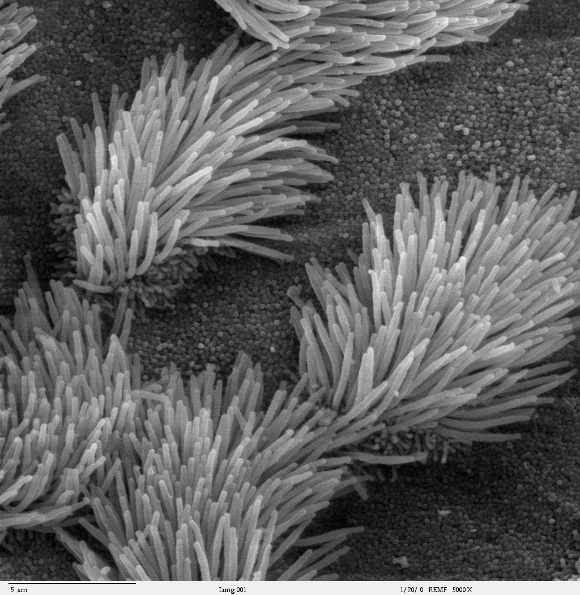
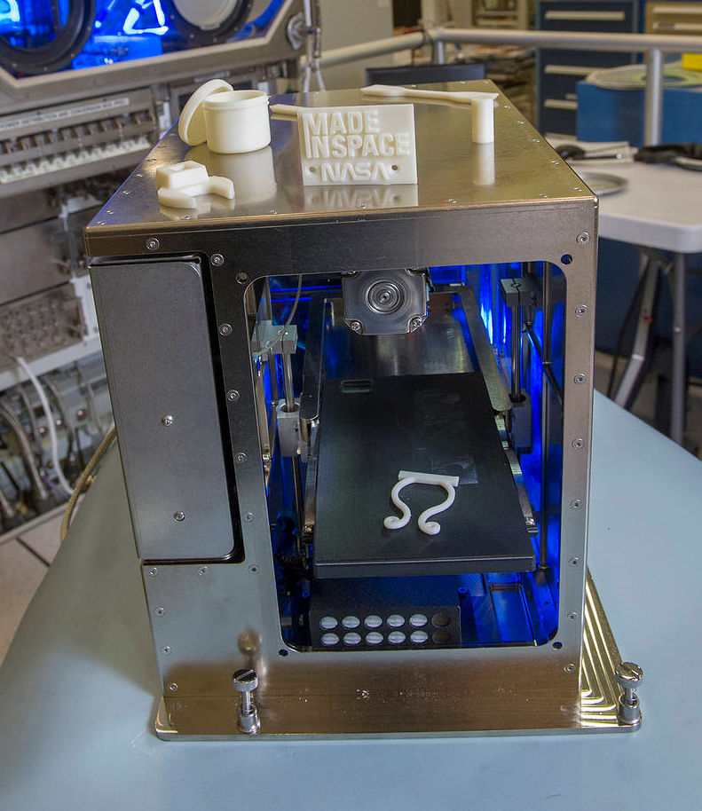
HOW CAN WE REDUCE THIS BUILD UP?
3
The two main 3-D printers are filament and resin printers.
Cilia - are small hair-like protuberances on the outside of eukaryotic cells. They are primarily responsible for locomotion, either of the cell itself or of fluids on the cell surface.
Aldrich, A. Z. Assembling the Facts of Cilia Assembly and Function https://today.uconn.edu/school-stories/cilia-function/# (accessed Feb 21, 2020).
Dunbar, B. International Space Station’s 3-D Printer https://www.nasa.gov/content/international-space-station-s-3-d-printer (accessed Feb 21, 2019).
Biologydictionary.net Editors. Cilium https://biologydictionary.net/cilium/(accessed Apr 2, 2019).

Slide 4
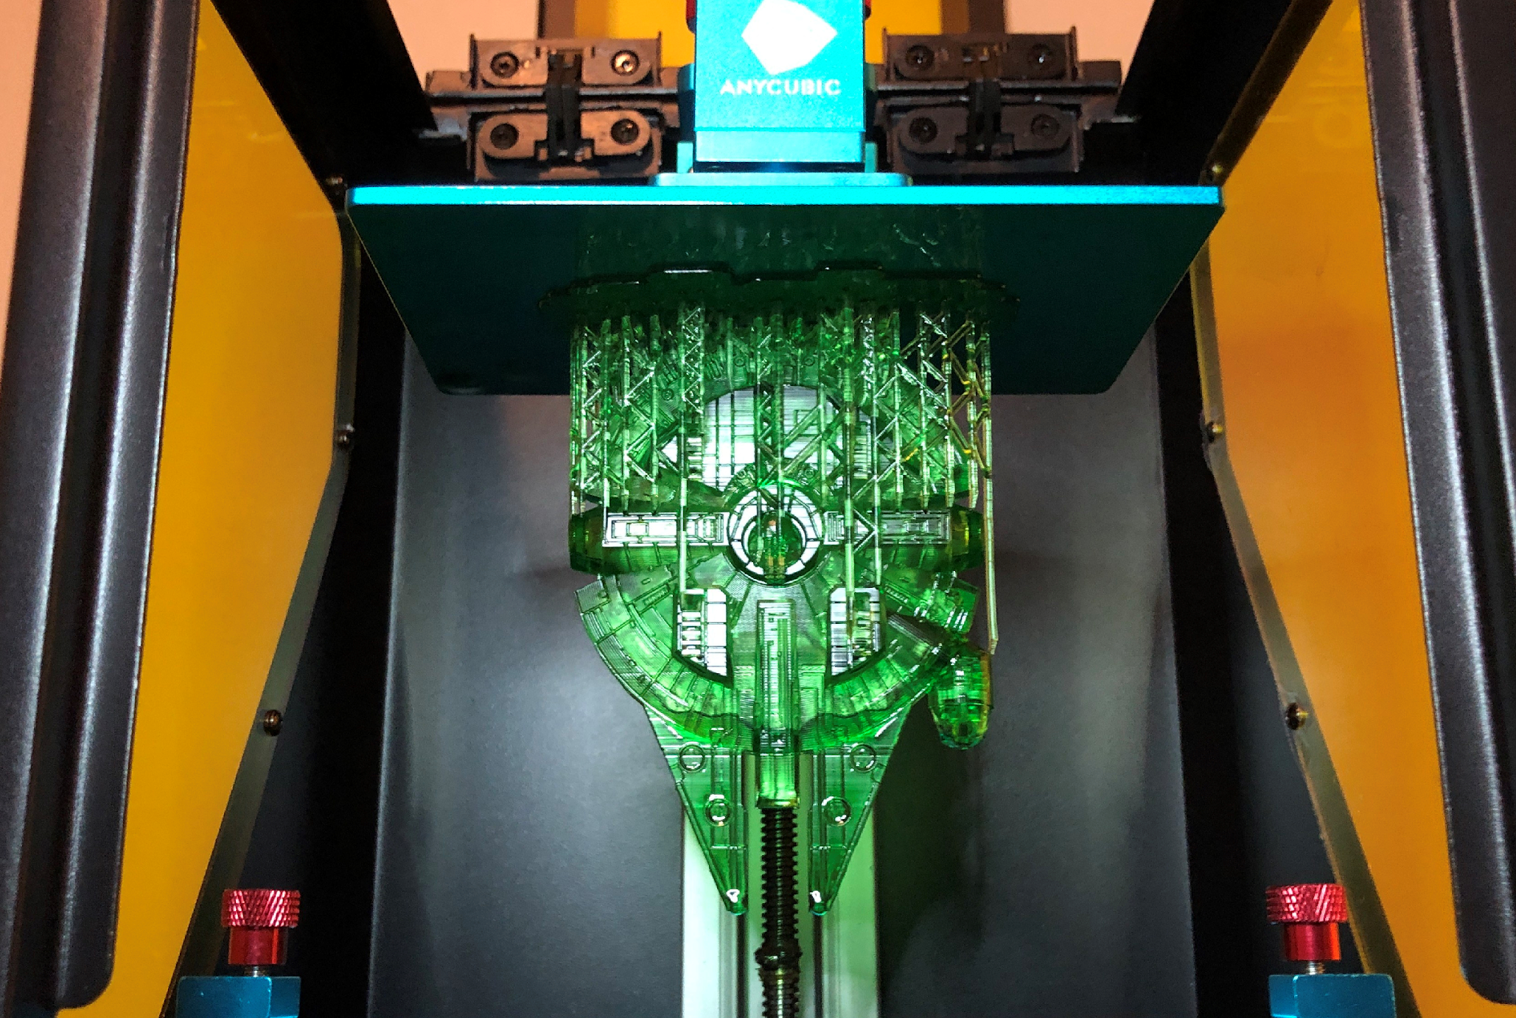
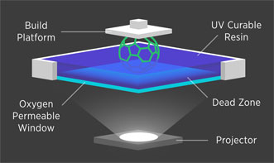
PRINTING WITH RESIN
4
Issues that can arise while printing include fluorinated ethylene propylene (FEP) film integrity and whether or not the model adheres to the build plate.
Biehler, J. A Week with the Anycubic Photon resin 3D printer https://johnbiehler.com/2019/01/29/a-week-with-the-anycubic-photon-resin-3d-printer/ (accessed Feb 21, 2020).
Additive Manufacturing Research Group https://www.lboro.ac.uk/research/amrg/about/the7categoriesofadditivemanufacturing/vatphotopolymerisation/ (accessed Feb 21, 2020).

Slide 5
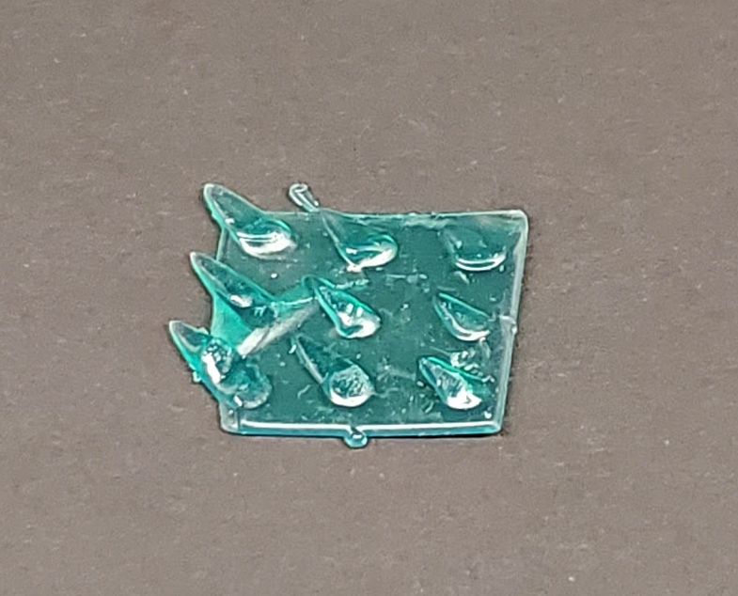
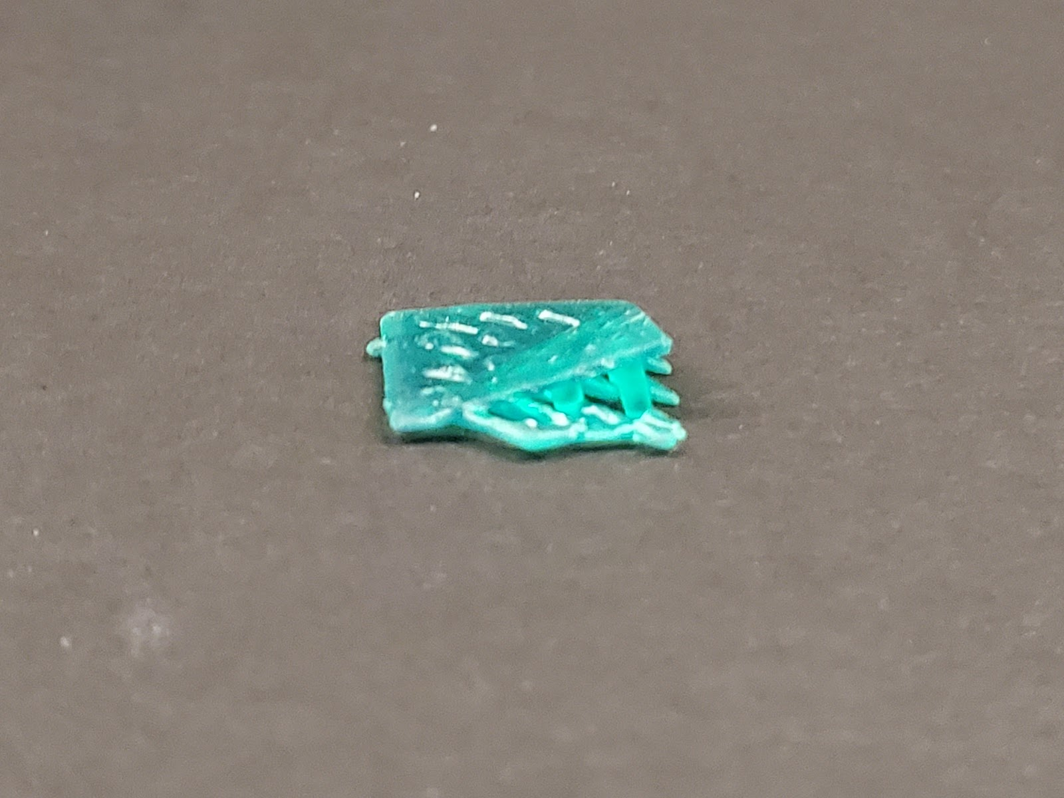
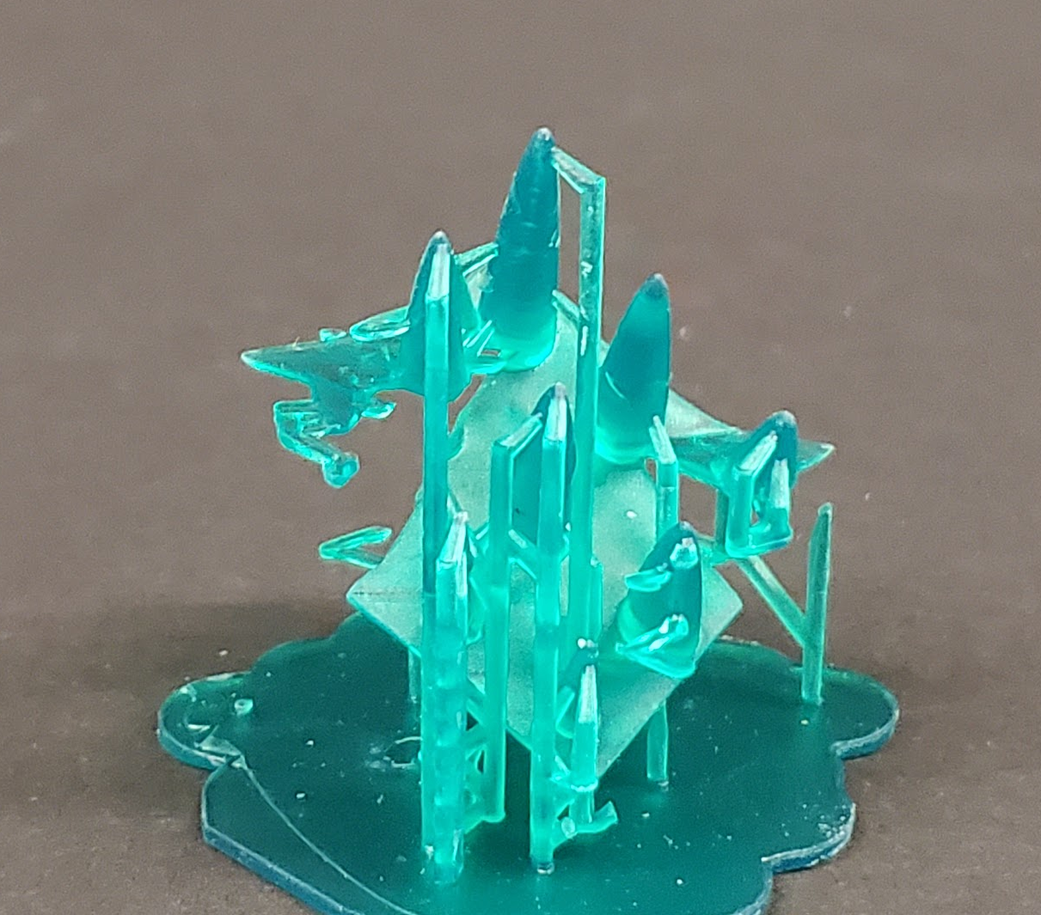
THE NUMBER ONE ISSUE WAS RESIN TEMPERATURE…
5

Slide 6
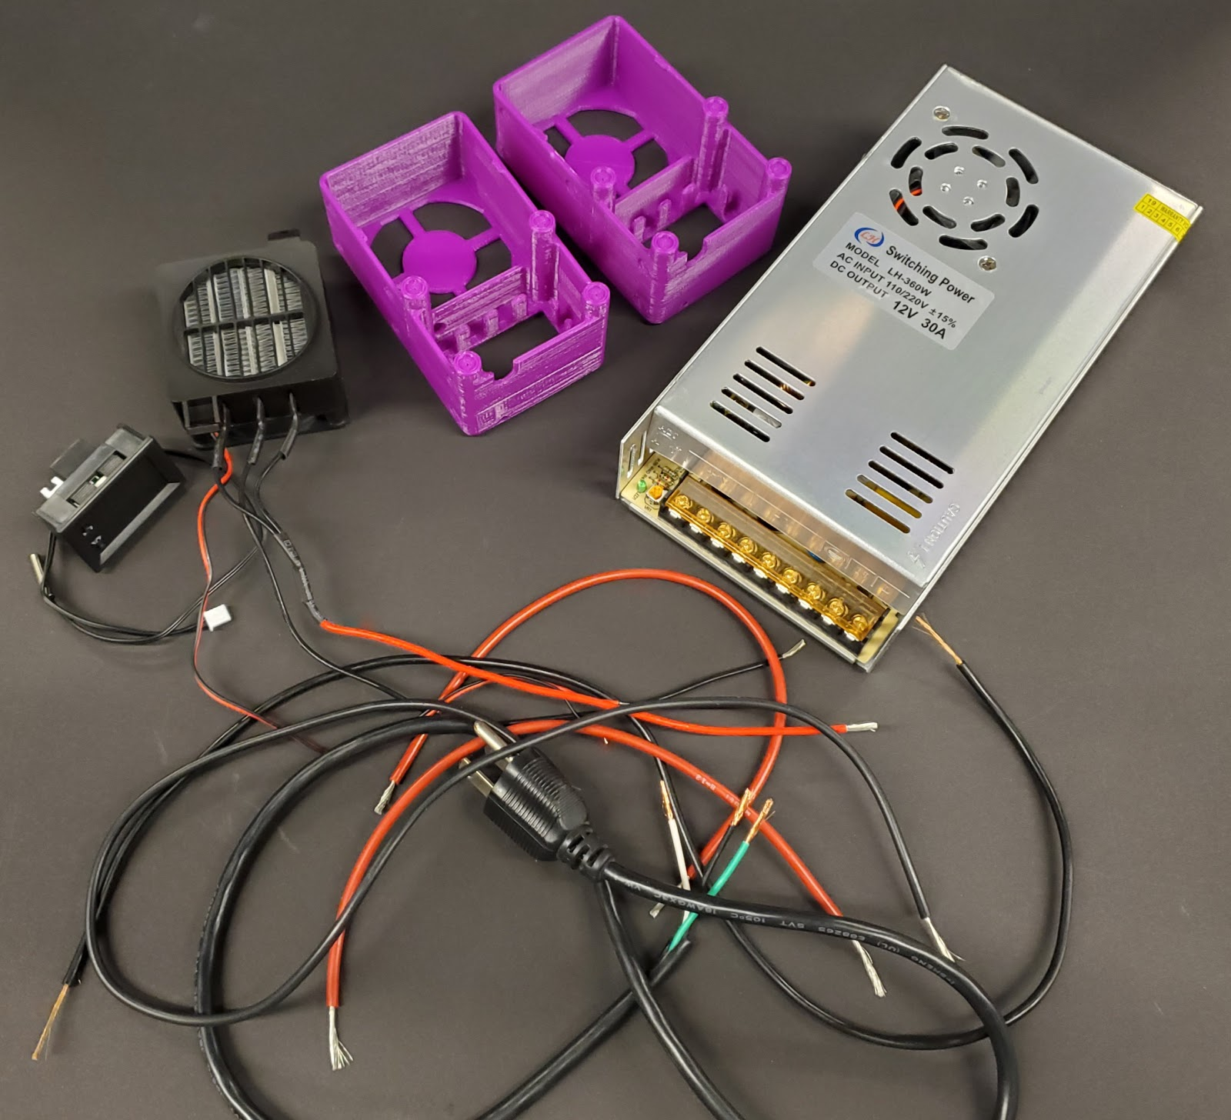
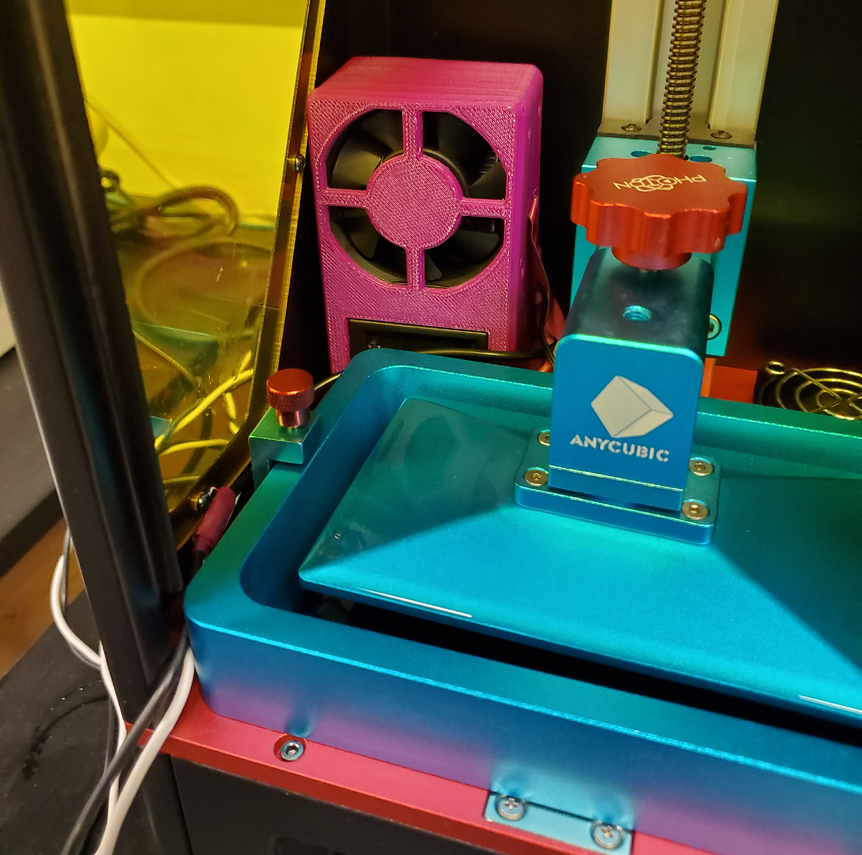
TO FIX THIS ISSUE…
6
…we built our own heating unit from scratch! This included strippng multiple cords and soldering the correct wires together.

Slide 7
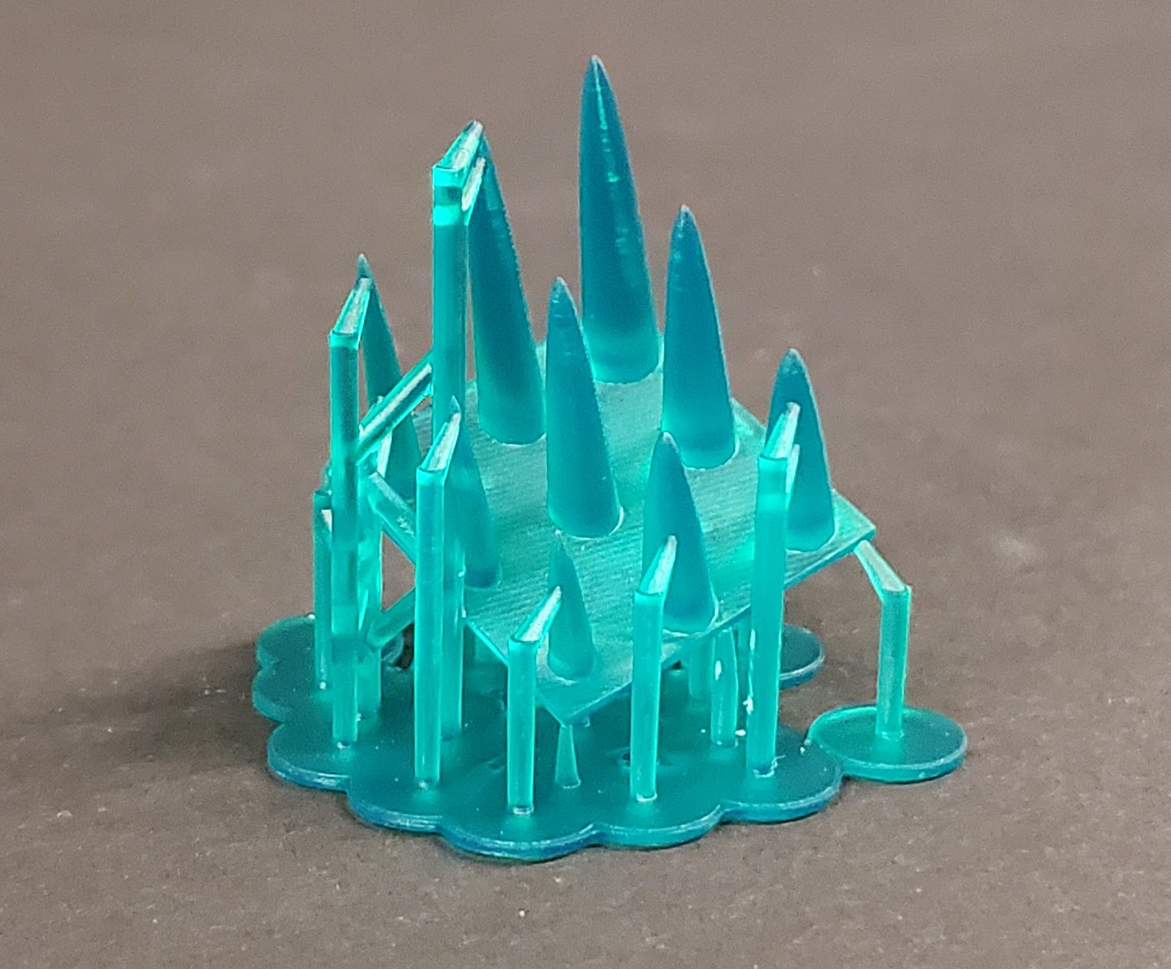
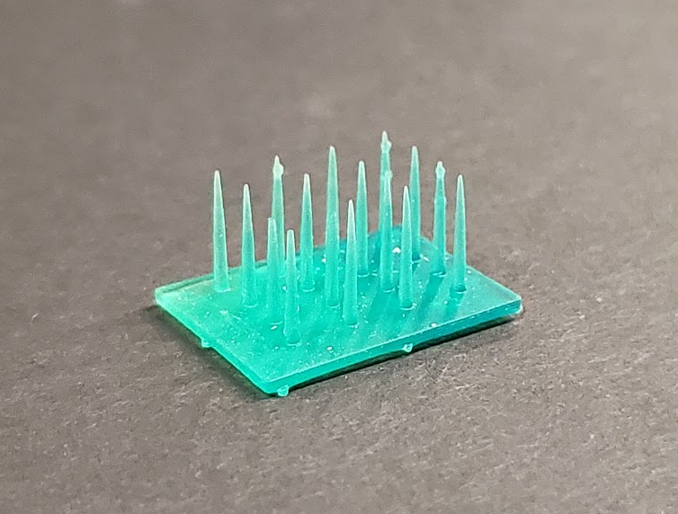
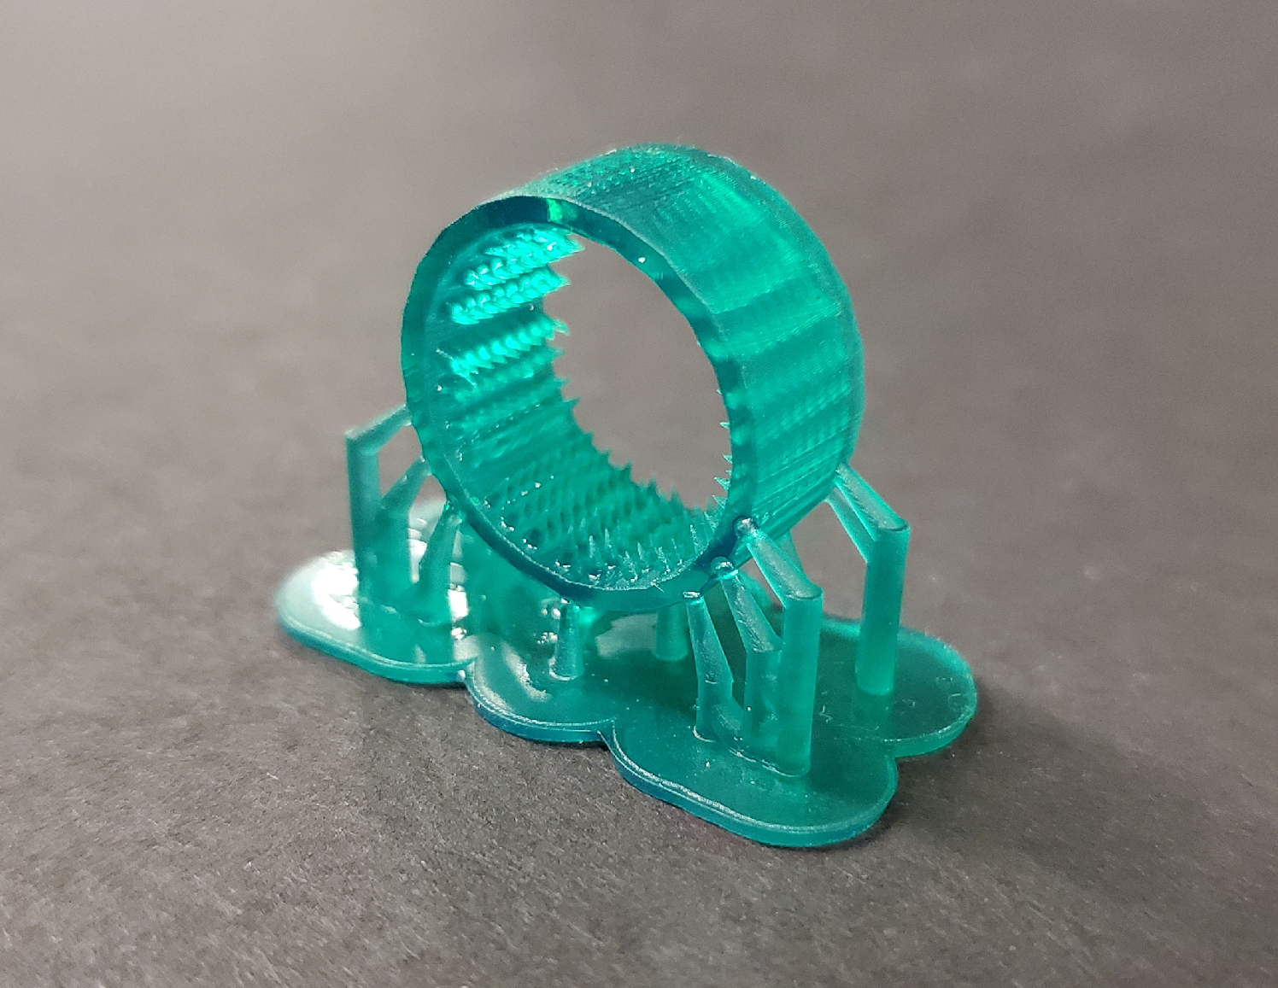
…HEATING THE RESIN RESULTED IN SUCCESSFUL PRINTS
7
26mm
20mm
15mm
21mm
20mm
23mm

Slide 8
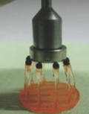
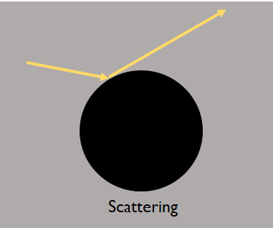
IN THE FUTURE, WE PLAN TO SYNTHESIZE MAGNETIC NANOPARTICLES USING POTATOES
8
The addition of magnetic nanoparticles could provide a source for the light to scatter...this would not be good for printing purposes.
Ji, Z.; Yan, C.; Yu, B.; Wang, X.; Zhou, F. Multimaterials 3D Printing for Free Assembly Manufacturing of Magnetic Driving Soft Actuator. Adv. Mater. Interfaces 2017, 4 (22), 1–6. https://doi.org/10.1002/admi.201700629.
Notes:
The starch that is present in potatoes serves as the reaction medium and as a reducing agent.

Slide 9
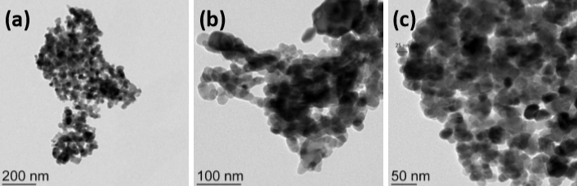
PREVIOUS RESEARCH SHOWS PARTICLE SIZE IS NOT AN ISSUE!
9
These transmission electron microscope images instill great confidence that the light will not be scattered!
Sharma, R. K.; Yadav, S.; Gupta, R.; Arora, G. Synthesis of Magnetic Nanoparticles Using Potato Extract for Dye Degradation: A Green Chemistry Experiment. J. Chem. Educ. 2019, 96 (12), 3038–3044. https://doi.org/10.1021/acs.jchemed.9b00384.

Slide 10



ACKNOWLEDGMENTS
10
Funding for this project was provided through the NAU/NASA Space Grant Undergraduate Research Scholarship Program. Thank you to Paloma Davidson and Dr. Nadine Barlow for your guidance on our presentations.
Thank you to Dr. Stephanie Hurst for accepting me into her research group and encouraging me as a chemist. I want to thank my laboratory partners Michael Moghadasnia, Patrick Cross, Alexandra Novacek, Justin Case, Andrew Foss, and Ryan Evans.

